Slide 1
Amino acid disorders II
Johan Van Hove
Amino acids
  Glycine
  Serine
Vitamins in the brain
  Riboflavin
  Thiamin
  Folate
Curtis Coughlin
Lysine pathway disorders
  Glutaric aciduria type I
  Pyridoxine-dependent epilepsy
Pyridoxine disorders
Not covered: Lipoate disorders, iron-sulfur clusteropathies, GLYT1

Slide 2
Glycine
Glycine encephalopathies

Slide 3
Glycine encephalopathies: nosology
Genetic encephalopathies with elevated brain glycine
Nonketotic hyperglycinemia (NKH): deficient activity of the glycine cleavage enzyme
  Classic NKH: genes of the glycine cleavage enzyme
  Variant NKH: genes of the cofactor lipoate synthesis
  Cofactor pyridoxal-phosphate: mimics glycine encephalopathy
Glycine transporter disorders (GLYT1)
Transcription factors (HCFC1)
Transient NKH: A phenocopy (not genetic in origin)

Slide 4
Glycine cleavage enzyme
THF
Methylene-THF
NH₃
NH₂-CH₂-COOH
glycine
CO₂

Slide 5
Definition:
NKH =
deficient glycine cleavage enzyme activity
Serine
NFU1
ISC1
HSPAS9
HSCB
NH₃
SHMT
H₄-folate
CH₂=H₄folate
BOLA3
Glycine
IBA57
ISCA2
GSH
Lipoyl-E2
Fe-S
cluster
GLRX5
NH₂
T
AMT
PDH
KGDH
CH₂
LIPT1
SAM
S
SH
LIAS
H
GCSH
SH
SH
Lipoyl-H
Octanoyl-H
Apo-H
CO₂
LIPT2
P
GLDC
L
NAD
S
Octanoyl-mtACP
NH₂
Pyridoxal-P
S
CH₂
COOH
NADH + H⁺
mt FAS II
Variant NKH
Lipoate synthesis disorders
Classic NKH

Slide 6
Glycine encephalopathies
Glycine, plasma/CSF
CSF only
GLYT1 deficiency
GCE
deficient?
Spasticity
Arthrogryposis
Prolonged apnea
Hyperekplexia
Yes
No
Phenocopy
HCFC1
TF
NKH
Transient NKH
Extrinsic: IVIG
Organic acidemia: Ketotic hyperglycinemia
Medication: Valproate
NBS hyperglycinemia
Artificial: bloody CSF sample
Artefact: thrombin in serum tube
Vanishing white matter, POLG1, others
Homocysteine &
MMA elevation
Protein component
P-protein GLDC
T-protein AMT
Cofactor
Regulation?
Variant
NKH
Classic NKH
Lipoate deficient?
Pyridoxal-P deficiency
No
Yes
Developmental progress?
Yes
No
PNPO deficiency
PDE
PLPBP
other
Lipoate Deficiency
Syndromes
Severe NKH
Attenuated NKH
Unknown
Poor (DQ<20)
Intermediate (DQ 20-50)
Good DQ>50
LIAS – LIPT2
GLRX5
BOLA3
NFU1
IBA57

Slide 7
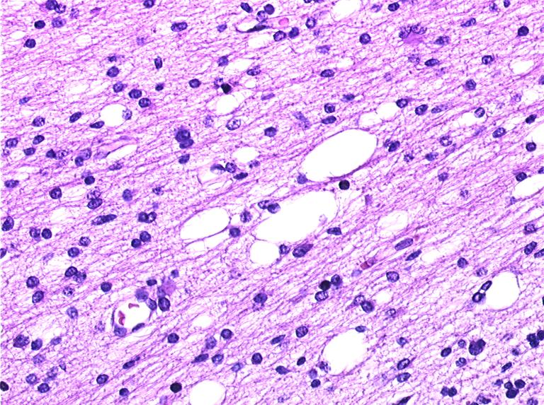
Cellular basis
Where is the enzyme?
Glycine cleavage enzyme present in
Liver (Hepatocytes) and some kidney cells
Placenta
Adult brain: Astrocytes: in the rostral part of the brain (not spinal cord, little brain stem)
Determined by where the P-protein is
H-protein is universal for lipoate synthesis
Pathology
  Spongiosis:
  Splitting of myelin lamellae
  at extracellular space, outer side of myelin

Slide 8
Severe NKH
Neonatal phase:
  First three days: lethargy, poor drinking, into coma
    No response to stimuli, including brain stem reflexes
    Hypotonia pronounced, hiccupping, myoclonic spasms
    Apnea (85%), may require ventilator support first 2-3 weeks
    EEG: burst suppression pattern
Early Infancy:
  All: resume breathing (D10-21)
  Some but not all: improved contact, often drinking spontaneously
Late infancy (3-12 months):
  No or minimal developmental progress: only smile, coo or rolling over
  Pyramidal tract signs (Babinski, hyperreflexia, spasticity)
  Increasing seizures, increasing antiepileptic medications (therapy resistant)
    EEG: hypsarrhythmia, then multifocal epilepsy
  Cortical blindness
  Feeding: usually by tube feeding
Late: scoliosis, hip dislocation, poor feeding status, respiratory compromise (need secretion management)
(classic NKH)

Slide 9
Attenuated NKH
Presentation:
  neonatal period (50%) (resemble severe NKH)
  Infancy: first months; if later: attenuated good
  Presentation: Hypotonia, lethargy, coma, seizures (treatable)
Variable developmental progress
  Learn to grasp, sit, walk, communicate
  Poor phenotype: DQ <20, seizures, autistic, absent speech
  Intermediate: DQ 20-50, hyperactive, chorea, poor speech, seizures
  Good phenotype: DQ 50-80, mainly hyperactive/behavioral issues
  Mildest case: only ADHD
Mild or no pyramidal tract signs
Seizures:
  None, or treatable with benzoate/dextromethorphan
  Can require one or two anticonvulsants - treatable
Hyperactivity!, chorea and ataxia can also be present
Episodic lethargy, usually with infections
Severe adverse reaction to valproate, sometimes with vigabatrin

Slide 10
Epilepsy - EEG
A formal study has never been done: It is much needed
Poor background:
  Neonate: burst suppression pattern
  Infant: hypsarrhythmia
  Multifocal epilepsy
  Myoclonic epilepsy, tonic epilepsy, multiple types
    Can rarely appear focal
Severe: therapy-resistant
Best antiepileptic drugs:
  Neonate: benzodiazepines (clonazepam, clobazam)
  Infant: topiramate, levetiracetam, sometimes felbamate
  Ketogenic diet (lowers glycine)
  Older: phenobarbital, vagal nerve stimulator
  NOT use valproate, vigabatrin: worsening at least in some

Slide 11
Biochemistry = first line test
Glycine is high
Elevated glycine in blood (not specific, not sensitive!)
Elevated CSF glycine = primary diagnostic indicator!
  Age dependent
  Very rarely normal in mild NKH
  Only reliable if no elevation of CSF protein
Elevated CSF:plasma glycine ratio – secondary parameter
  Normal ≤ 0.02 ; affected ≥ 0.08; 0.02-0.06 predicts attenuated
  Only reliable if 1. CSF glycine is elevated 2. sampling at same time

Slide 12
CSF glycine related to outcome DQ
Cutoff at 230 µM

Slide 13
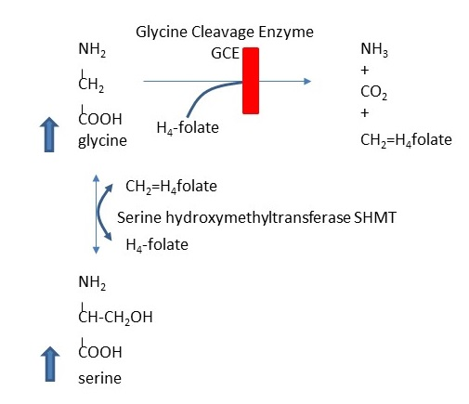
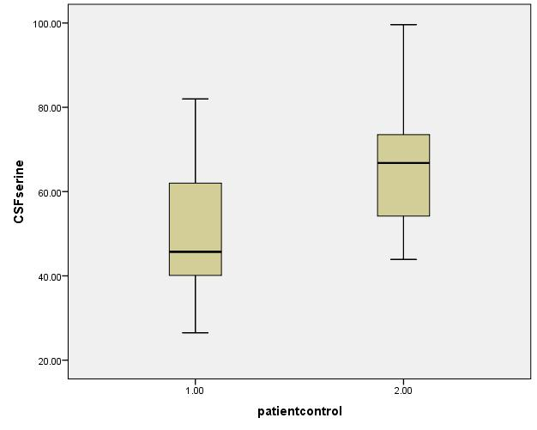
CSF glycine / serine versus controls age < 3 months
SHMT equilibrium
CSF serine
Deficiency of
Folate methylation
NKH patients
controls
CSF amino acid | NKH (26) | Control (13) | t-test | MWU
Glycine | 225±132 | 10±4 | p<0.001 | p<0.001
Serine | 52±14 | 67±18 | p=0.005 | p=0.014
Threonine | 78±35 | 62±27 | p=0.156 | p=0.125

Slide 14
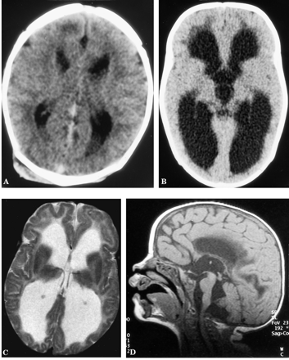
Radiology: Malformations
Retrocerebellar cystic area with hydrocephalus
  Obstruction at the aquaeduct: similar to the mouse models
NOT: corpus callosum absence, NOT gyral malformations

Slide 15
SEVERE NKH
Age 3.5 yrs
Atrophy
Globus pallidus
Cortex
Hippocampus
Cerebellum
Small corpus callosum
Persistent pattern or diffusion restriction

Slide 16
Diffusion restriction pattern evolves with age

Slide 17
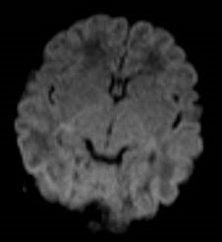
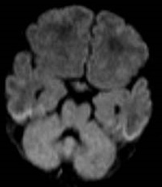
Transient nonketotic hyperglycinemia
There is no diffusion restriction in the first week.
DIAGNOSTIC DIFFERENCE

Slide 18
Corpus callosum length
True length of corpus callosum
Anteroposterior diameter of the corpus callosum
Predictor: Lowest values in attenuated: 32 mm
7 out of 10 severe patients below this value
Predictor: Lowest values in attenuated: 35.5 mm
6 out of 10 severe patients below this value

Slide 19
Corpus callosum thickness
Genu thickness
Body thickness
Isthmus thickness
Splenium thickness

Slide 20
Radiology: summary
Diffusion restriction:
  Diagnostic, but does not relate to outcome
Malformation:
  Only aqueduct hydrocephalus in <5% of severe NKH
Brain growth:
  Corpus callosum: short, thin, poor growth in severe more than attenuated
Brain atrophy:
  Older patients: globus pallidus, cortex, hippocampus, cerebellum
Mouse models

Slide 21
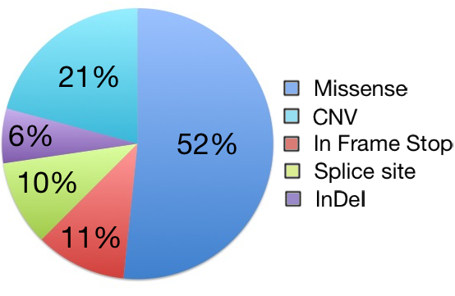
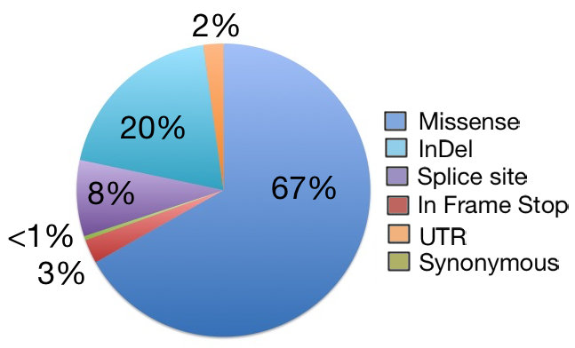
GENETICS
Classic NKH: GLDC and AMT Variants
In 562 unique families, sequencing and copy number variant analysis identified bi-allelic mutations in 550 cases.
-There was a 98% detection rate of pathogenic mutations - 410 unique mutations were identified: extensive intragenic allelic heterogeneity
  80% GLDC 20% AMT
Genet Med, 2017;19:104-111
LOVD

Slide 22
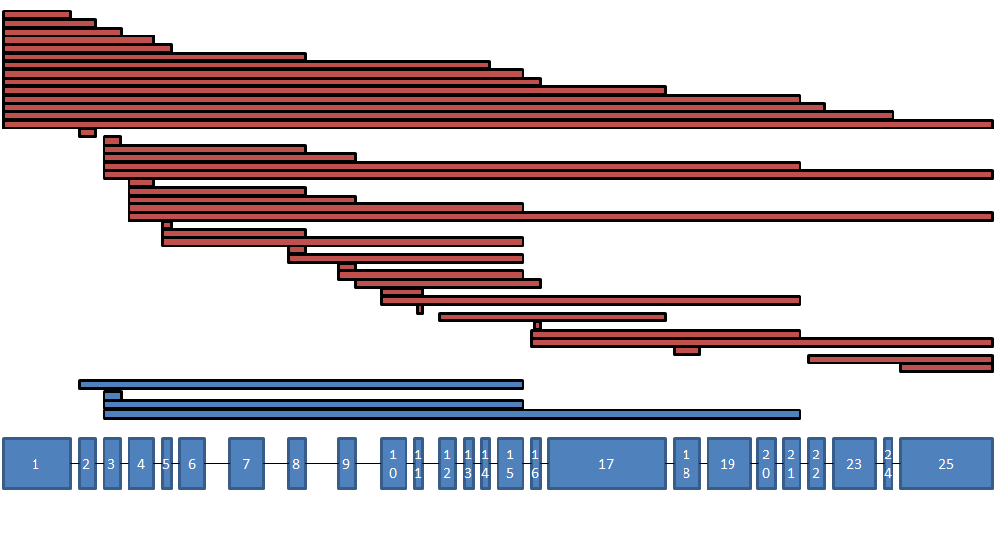
20% of GLDC variants were CNVs
Molecular testing must include exonic copy number variant analysis!
Neonatal/infantile epilepsy DNA panels do not include GLDC/AMT unless you request it!
Coverage for del/dup around exon 1 is not always correct (GC-rich region)

Slide 23
NKH in the Population
Population frequency
Identified all pathogenic alleles in ExAC database (unbiased)
GLDC: 1/171 carrier rate (0.58%)
AMT 1/660 carrier rate (0.15%)
Combined classic NKH 1/138 carrier rate
Minimal disease incidence: 1:76,000 (1:60,000 British Columbia)
Ethnic variation: Certain populations have specific mutations
UK: GLDC variant p.Arg515Ser
The Netherlands: AMT variant p.Ile106Thr
Pacific islanders: GLDC variant p.Ser132Leu
Finland: 89% of alleles: GLDC p.Ser564Ile, p.Gly761Arg, deletion of exons 1-8.

Slide 24
Mutant alleles with residual activity and disease severity
2 null mutations: severe outcome
1 null and 1 mild mutation: attenuated outcome
2 mild mutations: attenuated intermediate to good outcome
Developmental outcome
Epilepsy severity

Slide 25
Role of genetics
Genetics is important
  Number of good mutations relates to outcome
    Two bad mutations: always severe outcome
    One good mutation: chance of attenuated outcome
  Permissive effect
Genetics is not everything
  Poor relation of residual activity to outcome
  Same genetics: different outcome
  Modifying factors are important
    Genetic
    Nongenetic: treatment – other
    Mouse studies
Gene augmentation therapy
under development
Notes:
Of

Slide 26
Current treatment: reduce glycine with benzoate
Principle: Excess glycine overstimulates NMDA receptors: reduce glycine and block receptor (1990-1993)
REDUCE GLYCINE: BENZOATE and DIET:
Benzoate:
  Benzoate → benzoyl-CoA + glycine → hippurate → urine excretion
    Liver enzymes
  Starting dose: Attenuated: 300 mg/kg/d; Severe: 500 mg/kg/d;
  Increase gradually while monitoring plasma glycine levels
  Treatment goal: plasma glycine 120 – 300 µM, 1-2 hrs after a dose
  Toxicity risk if glycine < 125 μM
Diet: Glycine in food is low, Dietary restriction: difficult to control severe
Ketogenic diet: uses glycine as gluconeogenic substrate: lowers glycine
  Sharp reduction in benzoate dose needed!!
Unresolved Questions:
  does benzoate lower glycine levels in the brain: glycine by MRS
  Improving benzoate: microgranular coated / prodrug

Slide 27
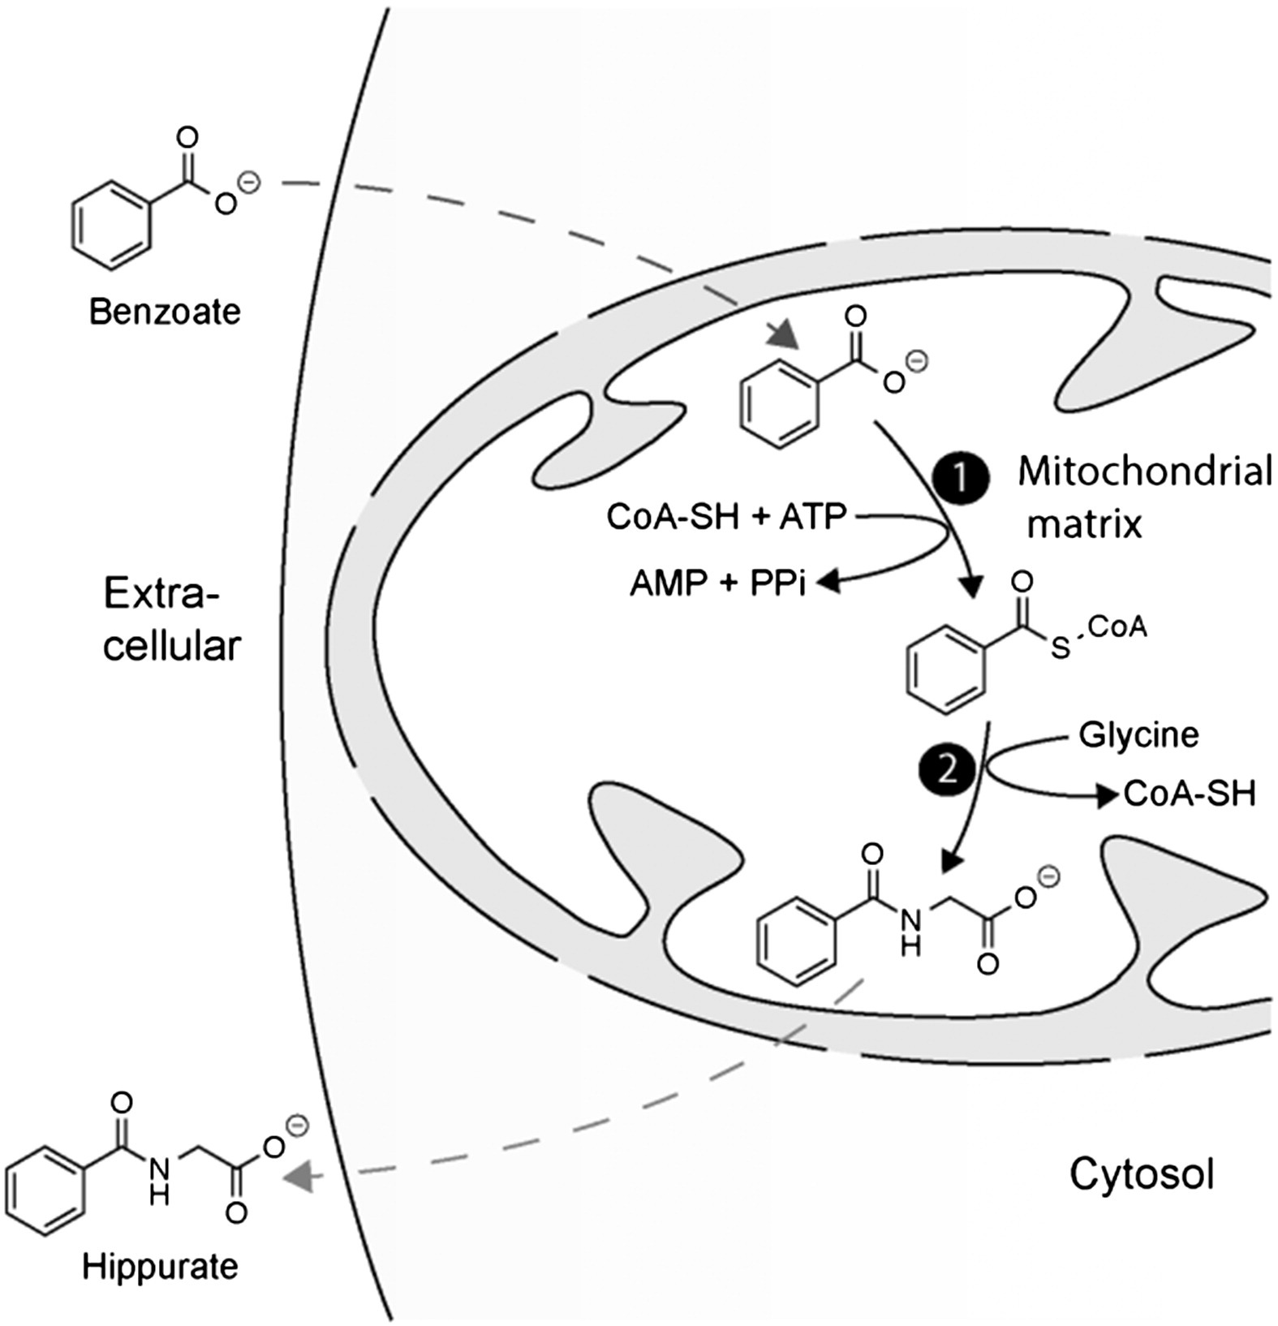
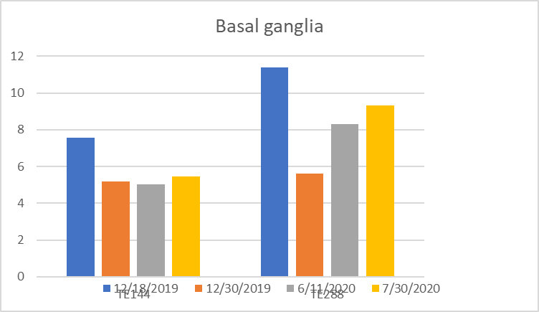
Sodium benzoate: overview
Sodium benzoate is conjugated to glycine to form Hippurate
First published studying on lowering glycine occurred over 80 years ago (
  J Clin Invest; 27(5),1948
LIVER – renal tubular cells
Lowers glycine in plasma
Lowers glycine in brain: MRS data
Lennerz et al, Mol Genet Metab, 2015

Slide 28
When to obtain glycine – benzoate levels?
Glycine & benzoate levels throughout the day in NKH patient
Obtain level 1-2 hours after a dose of benzoate: through glycine, peak benzoate

Slide 29
Glycine endogenous
synthesis
including protein catabolism, SHMT
Food
glycine + serine
SHMT
Ketogenic diet
?constant
IN
Plasma glycine
in balance (normal levels)
Glycine endogenous use
OUT
OUT
Glycine cleavage enzyme
Benzoate
Urinary hippurate excretion
Neurologic outcome ?

Slide 30
Pathophysiology: Neurotransmitter disorder
Glycine inhibitory neurotransmitter in spinal cord (inhibition by strychnine) -- relation to hypotonia and apnea?
Stychnine: increased tone and respiration, but no consistent clinical effect on mental outcome
Glycine allosteric activator of NMDA receptor: excitatory
NR1/NR2 receptors
NR1/NR3 receptors
Other neurotransmitters normal
Na⁺
Ca⁺⁺
Glutamate
+
Dextromethorphan
Glycine
+
NR2
NR1
Mg⁺⁺
K⁺

Slide 31
Current treatment: block NMDA receptors
Glycine is activator on NMDA receptor: overstimulation → use receptor blockers (dextromethorphan – ketamine)
DEXTROMETHORPHAN : Uncompetitive NMDA receptor antagonist
KETAMINE: Used in Israel and Japan, limited personal experience
DMP dose increase in child with attenuated poor NKH on ketogenic diet:
“She seems overall stronger. She is putting more weight into her legs and her neck. Her seizure decreased and we actually had 3 days in a row without seizures. She doesn’t seem to have as much nystagmus either. I am excited to see what the next increase will bring.”
Dextromethorphan:
treatment recommendation
 | Dose of dextromethorphan
Infant | 10 mg/kg/day
Child | 5 mg/kg/day
Adolescent / adult | 3 mg/kg/day
Recommended dose: 3-10 mg/kg/day
underdosing no therapeutic effect
different from cough suppressant dose
The dose of dextromethorphan depends on:
CYP2D6,CYP3A4, UGT1A1 genotype
  Slow metabolizers (~6% of populations)
    Toxic at these doses
  Other medications may inhibit
Individual dextromethorphan levels
Neudexa: DMP with quinidine sulfate
 | Timing of dextromethorphan
Extended release dextromethorphan | 2 doses per day
Non-extended release dextromethorphan | 4 doses per day
Dosing is experience based, no scientific systematic data

Slide 32
Treatment effect
Severe patients:
  Limited efficacy: more alert, breathing, easier seizure control
  Developmental level: not affected
Attenuated patients: accumulating evidence of real efficacy
  Benzoate: stabilization from episodes of CNS depression
  Dextromethorphan (dose high)
    restore school functionality, resolve severe lethargy and severe chorea
  Impact on cognitive outcome of benzoate+DMP/ketamine:
    Effect depends on: mutation severity – timing: developmental window

Slide 33

Mutation residual activity
2 severe mutations
No activity
1 or 2 mild mutations
Substantial activity
Severe outcome
Attenuated outcome
No impact of current treatment
on ultimate outcome
Impact of current treatment
We must find a real treatment
for severe NKH
Developmental window: Age at start
Extent of treatment: strictness
early identification of candidates!

Slide 34

It’s a new dawn for NKH
It’s THERAPY, stupid

Slide 35
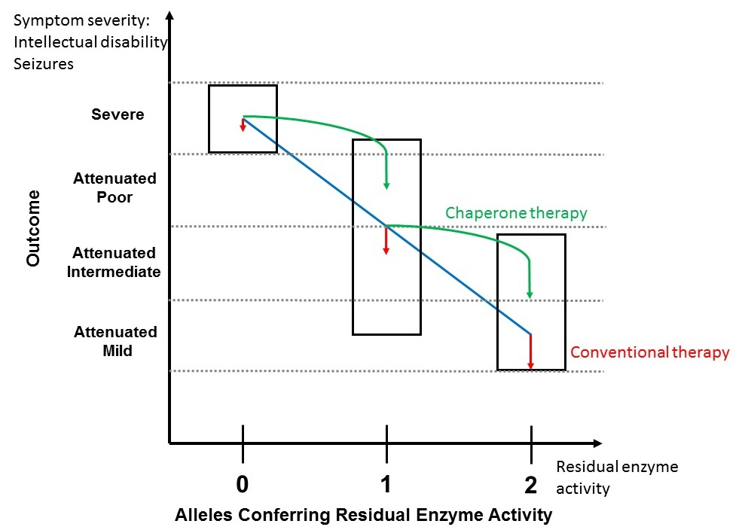
Therapeutic strategies
Chaperone therapy
Gene therapy
mRNA therapy
Biochemical pathogenesis
Glycine toxicity
Deficient folate methylation
therapy effective in brain mito
Neurophysiology pathogenesis
NMDA receptor overactivation (NR1/NR2)
NR1/NR3 receptor overactivation glycine / D-serine

Slide 36
Serine
Serine synthesis disorders

Slide 37
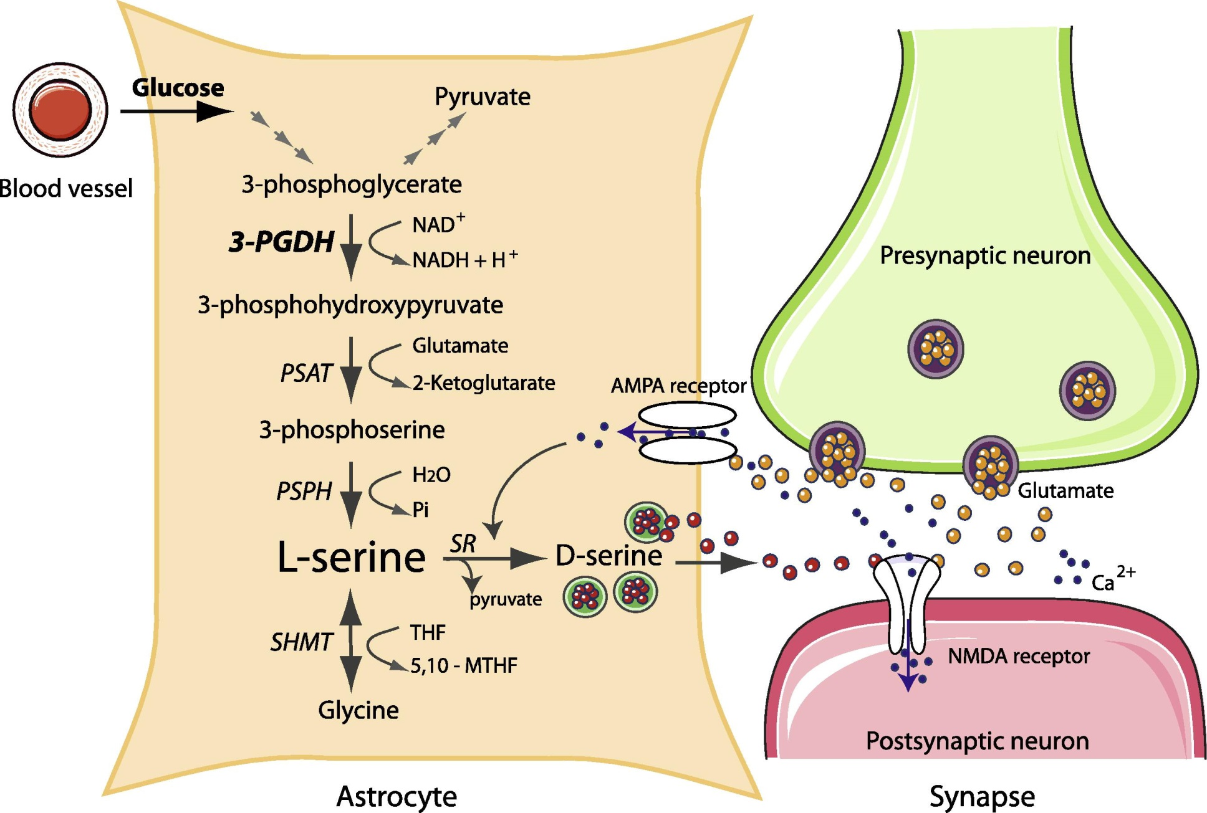
L-Serine synthesis
3-Phosphopglycerate dehydrogenase
Phosphoserine amino-transferase
Phosphoserine phosphatase

Slide 38
D-L-Serine Functions
Essential role in the developing brain (3-PGDH is highly expressed in fetal brain), and function of the CNS
  improves survival of neurons
  precursor for phospho-/sphingolipid synthesis (deoxysphingolipids )
  D-serine neurotransmitter role
If L-serine synthesis is impaired: 3-PGDH knockout mouse model, brain development is disrupted-lethal severe neurodevelopmental problems.
Primarily synthesized in astrocytes (not neurons) in the brain
  essential amino acid for neurons
  limited transfer blood-brain barrier for serine and glycine.

Slide 39
Disorders of L-serine synthesis: 3-PGDH deficiency
Ultra-severe: Neu-Laxova syndrome
Severe neonatal/infantile form presents with,
  Congenital microcephaly, intractable seizures, and profound psychomotor retardation.
  Abnormal EEG patterns (hypsarrhythmia, multifocal)
  MRI abnormal (hypomyelination, lack of white matter)
Milder juvenile phenotype has been reported,
  Absence seizures, moderate developmental delays, without microcephaly.
Diagnosis:
  Plasma: marginally low serine (fasting sample)
  CSF: very low serine (typically 6-8 μM normal 35-80 μM), low glycine
  Poor phenotype correlation with genotype or biochemistry
  Genotyping or Enzyme assay (phosphoglycerate dehydrogenase in fibroblasts)
Treatment with high dose L-serine, 200 – 600 mg/kg/day,
  some glycine 200 mg/kg/day
  Improved seizures, improved myelination.
  For normal development needs prenatal treatment

Slide 40


Slide 41
Prof. Curtis Coughlin
Lysine
Pyridoxine

Slide 42
B Vitamins and brain
Riboflavin
Thiamin
Folate

Slide 43
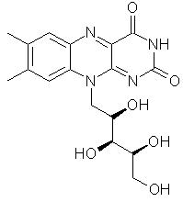
Riboflavin

Slide 44
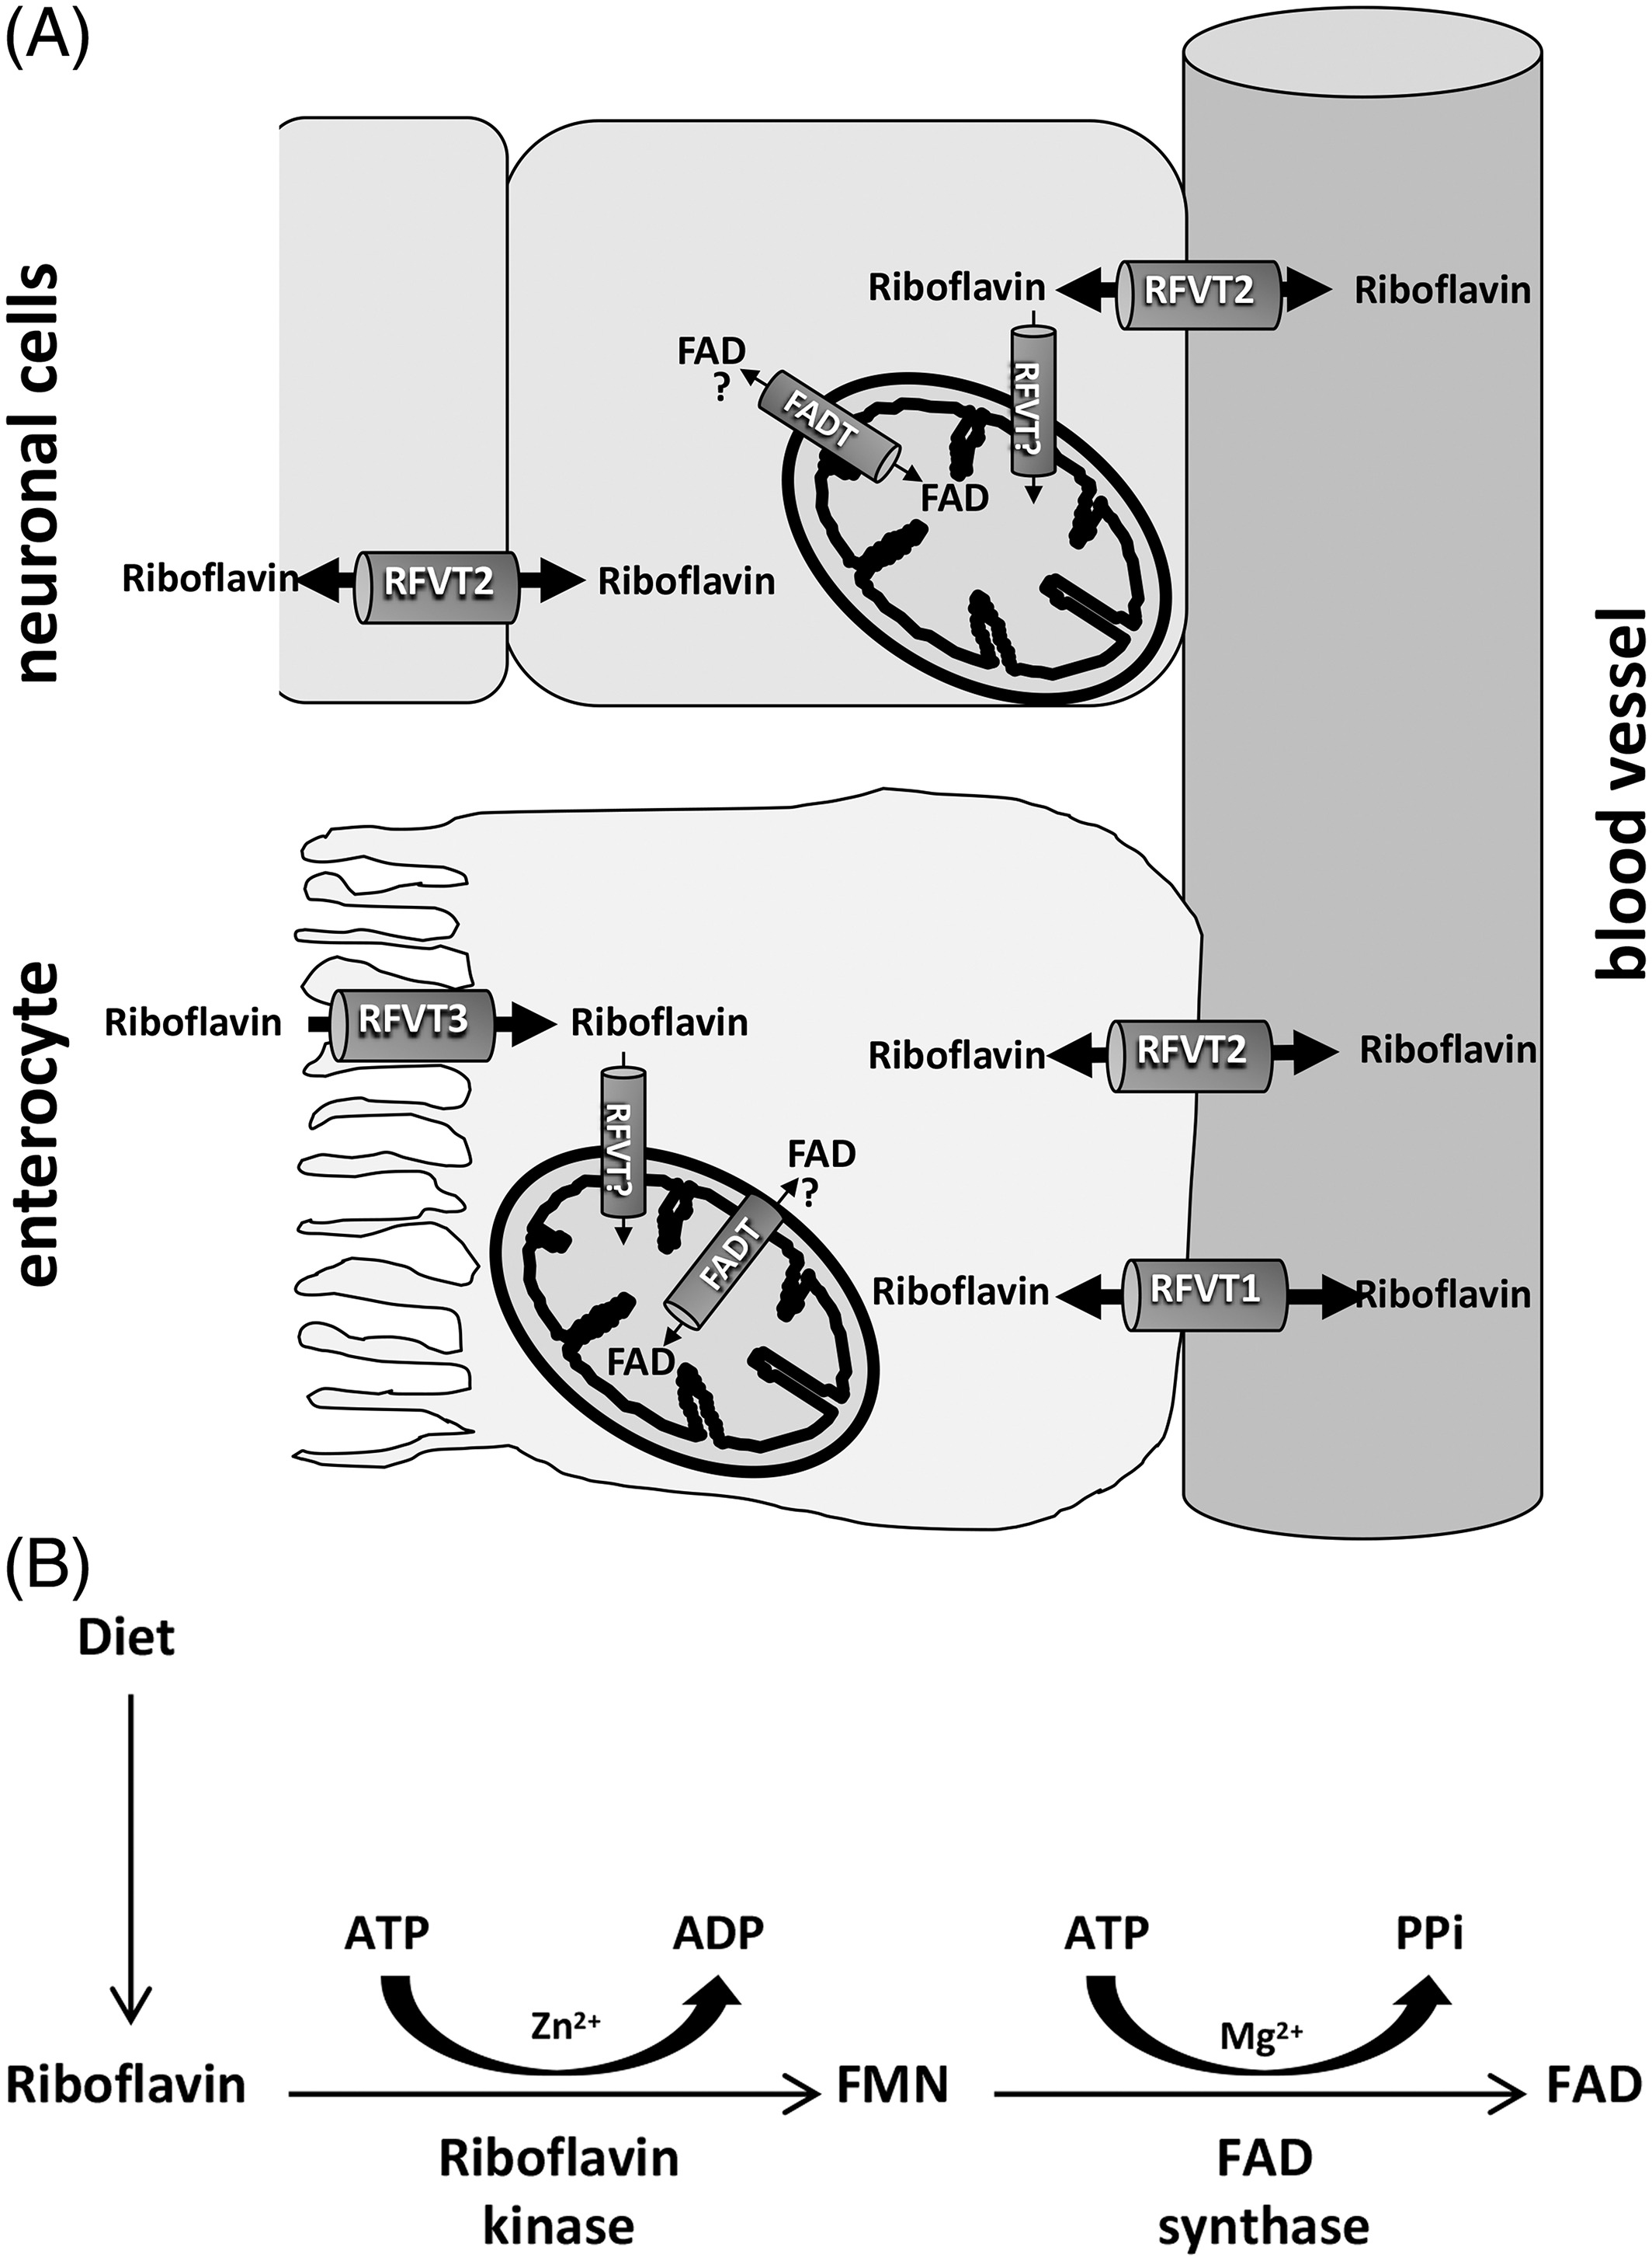
Riboflavin transport:
Placental transfer: RFVT1
Enterocyte Entry: RFVT3
Exit enterocyte: RFVT1
Entry tissues (brain): RFVT2
Mitochondria entry: FADT SLC25A32
Activation - biochemistry:
Riboflavin kinase RFK
FAD synthase FADS
90 flavoproteins
16%FMN – 84% FAD
Examples:
Fatty acid oxidation enzymes
Branched AA enzymes
ETF- ETFDH
Complex I: ACAD9, FOXRED1,
NDUFV1, NDUFV2
Complex II: SDHA
Jrnl of Inher Metab Disea, Volume: 42, Issue: 4, Pages: 608-619, First published: 24 January 2019, DOI: (10.1002/jimd.12058)
Notes:
(A) Dietary flavin adenine dinucleotide (FAD) and flavin mononucleotide (FMN) are converted to riboflavin by hydrolases at the brush border of ileal enterocytes. Riboflavin is then absorbed into the intestine via apically expressed RFVT3 (also known as hRFT2) and released into portal blood by basolaterally expressed RFVT1 (also known as hRFT1) and RFVT2 (also known as hRFT3). Circulating plasma riboflavin is transported in blood bound to either albumin or immunoglobulins. RFVT2‐mediated transport allows riboflavin uptake into the brain. The precise mechanism of import of riboflavin into the mitochondrial matrix has not been established to date. We have depicted RFVT? as a putative riboflavin transporter responsible for this step. Subsequent conversion into flavocoenzymes occurs in tissue cells, as shown in (B). The mitochondrial FAD‐transporter (FADT) is an inner mitochondrial membrane carrier that imports FAD from the cytosol into the mitochondria. The question mark indicates that FADT‐mediated efflux of FAD from the mitochondrial matrix to the cytosol remains to be established. See also Barile et al. (B) After cellular uptake of riboflavin, flavocoenzymes are formed by a sequential pathway involving riboflavin kinase and FAD synthase. Both steps require ATP. Zn2+ is the preferred metal ion which facilitates the γ‐phosphate exchange catalysed by riboflavin kinase, whilst Mg2+ is used in the adenylation catalysed by FAD synthase
IF THIS IMAGE HAS BEEN PROVIDED BY OR IS OWNED BY A THIRD PARTY, AS INDICATED IN THE CAPTION LINE, THEN FURTHER PERMISSION MAY BE NEEDED BEFORE ANY FURTHER USE. PLEASE CONTACT WILEY'S PERMISSIONS DEPARTMENT ON PERMISSIONS@WILEY.COM OR USE THE RIGHTSLINK SERVICE BY CLICKING ON THE 'REQUEST PERMISSIONS' LINK ACCOMPANYING THIS ARTICLE. WILEY OR AUTHOR OWNED IMAGES MAY BE USED FOR NON-COMMERCIAL PURPOSES, SUBJECT TO PROPER CITATION OF THE ARTICLE, AUTHOR, AND PUBLISHER.

Slide 45
Riboflavin transporters
RFVT1: heterozygous, low riboflavin in newborn, biochemical abnormalities, responds to riboflavin, transient
RFVT2 and RFVT3: Brown-Vialetto-Van Laere and Fazio-Londe (= BVVL + deafness)
Hearing loss: 87%
Muscle weakness: 83%, low DTR
Sensorimotor neuropathy on EMG: 89% - on biopsy axonal neuropathy
Bulbar symptoms (dysphagia, dysarthria, tongue weakness): 56%
Facial weakness: 28% (RFVT3)
Optic atrophy: 46% (RFVT2) – nystagmus 16%
Gait abnormality – ataxia: 36 % (RFVT2)
Respiratory symptoms: 62%
Feeding difficulties: 38%
Biochemistry: abnormal acylcarnitines, organic acids 52%; abnormal flavins 24%
Therapy riboflavin 10-80 mg/kg/day: majority improve, better if treated early
  Can take days to months to response PATIENCE

Slide 46
Riboflavin and mitochondria
FADT – SLC25A32: riboflavin responsive myopathy: ragged red fibers, decreased SDH staining, in fibroblasts: decreased succinate-cytochrome c oxidoreductase
RFK: no cases yet / (also linksTNFR1 and NADPH oxidase)
FADS: lipid myopathy, MADD like biochemical changes, multiple RCE deficiencies
85% present in infancy: severe myopathy, feeding difficulties, respiratory deficiency
Some cardiomyopathy, SVT, cardiac arrest
Late-onset: muscle weakness, foot drop, arm weakness
Biochem: MADD picture of Acylcarnitines and Acylglycines
RCE: decreased complexes I, II, III / abnormal flavin profile in muscle
Riboflavin treatment: partial response on muscle, on biochemistry

Slide 47
5-Formyl-Tetrahyrdofolate Folinic Acid
FOLATE
N
N
H
H₂
N
H
1
8
H
O
H
COOH
2
7
3
5
6
N
C
N
N
4
CH₂
CH
H
N
9
10
OH
CH₂
C O
CH₂
H
COOH
Pteridine ring
Paramino benzoic acid
Glutamic acid
1-9 copies
Notes:
47

Slide 48
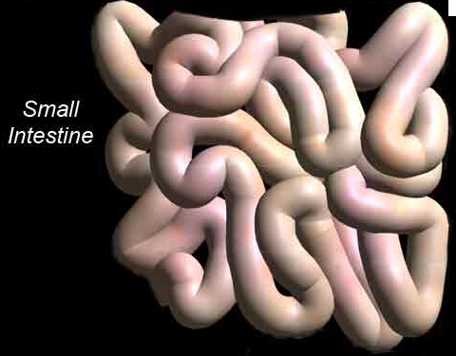
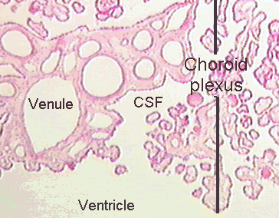
PCFT Mediates Folate Transport in the Intestine and Central Nervous System
Intestine
Choroid Plexus
lumen
blood
blood
CSF
PCFT
PCFT

Slide 49
Folate Receptor-alpha Also Mediates FolateTransport in the CNS
Choroid Plexus
FR-α
FR-α
blood
FR-α
CSF
PCFT
FR-α

Slide 50
Folate disorders
Folate transporter defect
  Low 5-methyltetrahydrofolate in CSF
  Genetic: FOLR1 folate transporter
  Non-genetic: autoimmune antibodies against folate transporter
    Increased with milk
    Diagnostic lab?
  Primary Mitochondrial disorders: Kearns-Sayre most documented

Slide 51
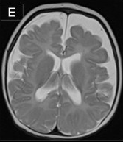
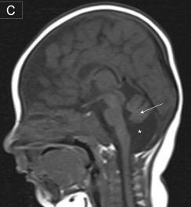
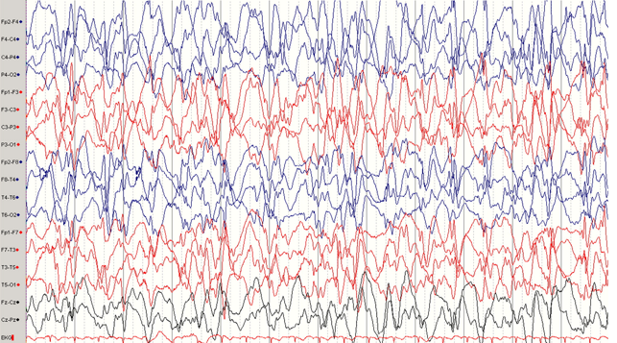
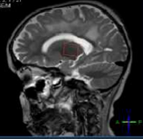
Central Nervous System Effects
Cerebral and CerebellarAtrophy
Ataxia
Seizures
Banka et al, Am J. Hum Genet 2011 (88) 216-225
Demyelination
Dill et al, Mol Gen Metab 2011 (104) 362-368

Slide 52
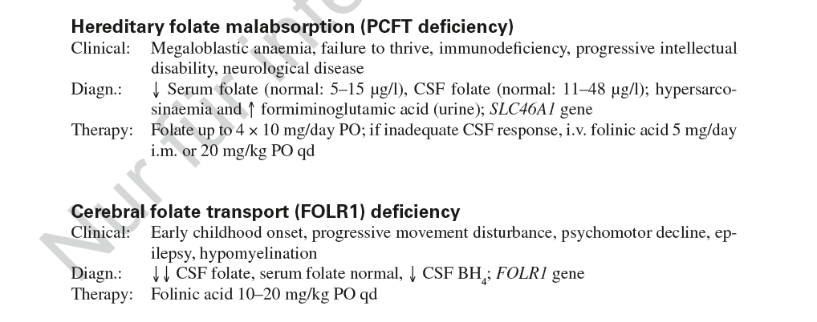

Slide 53
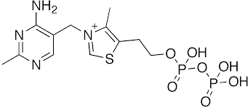
Thiamin

Slide 54
Biochemistry
Thiamine pyrophosphate, cofactor of:
  MITO
  Pyruvate dehydrogenase
  2-ketoglutarate dehydrogenase
  Branched chain keto-acid dehydrogenase
  PEROXISOMES
  2-hydroxyacyl-CoA lyase
Transporters:
  ThRT-1 SLC19A2 and ThTR-2 SLC19A3: gut,
  TPPT SLC44A4
  Mitochondrial transporter of TPP: SLC25A19
Metabolism
  T -> TPP: Thiamin pyrophosphate kinase TPK1
  Most of thiamin as TPP (: blood: 80% in rbc as TPP)

Slide 55
Disorders
Acquired:
  Infant: Beri-beri
  Adult: Wernicke
Genetic
Gene | Dysfunction syndrome | Disorder
SLC19A2 | Thiamine metabolism dysfunction syndrome 1 | Thiamine‐responsive megaloblastic anemia syndrome
SLC19A3 | Thiamine metabolism dysfunction syndrome 2 | Biotin‐ or thiamine‐responsive encephalopathy type
SLC25A19 | Thiamine metabolism dysfunction syndrome 3 | Microcephaly Amish type
 | Thiamine metabolism dysfunction syndrome 4 | Bilateral striatal degeneration and progressive polyneuropathy type
TPK1 | Thiamine metabolism dysfunction syndrome 5 | Episodic encephalopathy type
Table 2. Thiamine metabolism dysfunction syndromes nomenclature

Slide 56
Thiamin-responsive megaloblastic anemia syndrome: SLC19A2
Megaloblastic anemia
Diabetes mellitus
Deafness sensorineural (later)
Other:
  Neurological
  Ophthalmological
  Endocrinological
  Gastroenterological
  Hematological
  Other
Treatment: thiamin 25-100 mg/day
  Improves diabetes
  Less efficacy in adolescence

Slide 57
Clinical criteria:
a. SLC19A3: Acute or recurrent episodes of encephalopathy (decreased consciousness, irritability) with two or more of the following: (a) dystonia, (b) hypotonia, (c) bulbar dysfunction, (d) ataxia, and (e) seizures. Of note, 16% of patients may have an insidious onset of symptoms (psychomotor regression, clumsy or abnormal gait, and stiff limbs)
b. SLC25A19: Acute or recurrent episodes of encephalopathy with: (a) progressive peripheral neuropathy or (b) severe congenital microcephaly with brain malformations
c. TPK1: Acute or recurrent episodes of encephalopathy, with two or more of the following: (a) dystonia, (b) hypotonia, (c) ataxia, (d) seizures, and (e) developmental delay. Of note, some patients may have a nonepisodic early‐onset global developmental delay
Biochemical criteria
a. Normal total thiamine blood levels
b. Low free‐thiamine in CSF and/or fibroblasts (SLC19A3)
c. Low TPP in blood, muscle, and/or fibroblasts (TPK1)
d. High excretion of 2‐ketoglutaric acid in urine (common in TPK1 and SLC25A19, rare in SLC19A3)
Radiological criteria
a. MRI pattern compatible with Leigh syndrome (SLC19A3, SLC25A19, TPK1) or Wernicke's (SLC19A3)
i. SLC19A3: Symmetrical T2W hyperintensity of caudate, putamen, cortico/subcortical areas, and/or ventromedial thalamus. No involvement of mammillary bodies. Diffuse T2W hyperintensity of brain white matter (single adult patient reported)
ii. SLC25A19: Symmetrical T2W hyperintensity in the caudate and putamen
iii. TPK1: Symmetrical T2W hyperintensity in basal ganglia and cerebellum (dentate nuclei)
Therapeutic criteria: a. Clinical improvement after thiamine supplementation
Supportive criteria:
1. Consanguinity / 2. Trigger event (infection, vaccination, trauma, intense physical activity, etc.)
4. Absence of systemic features of mitochondrial disease
5. Increased lactate in blood and/or CSF, or presence of a lactate peak on MRS; Normal OXPHOS and PDHc activity in muscle and fibroblast

Slide 58
